Slide 1
Survivors of Natural Disasters

Slide 2

Our Persona: Janet
Janet is a live-in caretaker for a differently abled person. She is 49 years old, and is married with an adult daughter.
Our facets:
Memory and Attention
Mental State
Physical State
Community and Network
Access to Utilities

Slide 3
Why these facets? - Memory and Attention
Research suggests that many survivors of natural disaster may experience some form of cognitive impairment, especially short term.
Anxiety (common during a natural disaster) can also worsen certain aspects of cognition, which include memory.
Notes:
r
In Our Stories Beyond the Disaster [20]: wildfire survivor describes unreliable memory
“Katrina Brain” [9] is a similar effect described in survivors of the 2005 hurricane
Concussion, which can occur during natural disasters can have similar effects on short-term memory and attention.
Most survivors of natural disasters report feelings of fear and anxiety [Source P.11, P.12, P.13]
Anxiety has negative effects on attention and spatial navigation, among other things [Source P.29]

Slide 4
Why these facets? - Mental State
As mentioned earlier, survivors are fearful, worried about themselves and their family.
Studies confirm that survivors are in shock, and some experience symptom of PTSD.
Notes:
A survivor of bushfires has said, “nothing feels safe anymore”. [20]
The abstract from an interview with a Katrina survivor mentions: “After Katrina, people were distressed, crying , while waiting for rescue.” [7]
Another Katrina survivor: “I was crying and just wishing that we were with the rest of my family somewhere safe”. [8]
Traumatic stress appears to be mediated by loss of control over fear induced by exposure to unpredictable and uncontrollable earthquakes. [1]
Disasters are mostly unpredictable, which leaves the victims in a state of shock. [29]

Slide 5
Why these facets? - Physical State
Hunger
Injuries
Who didn’t evacuate?
Notes:
Hunger:
Natural disasters can seriously impair food stores and distribution, which may lead to widespread hunger [32].
In addition, consequences of natural disasters may make it more difficult for survivors to procure food [31].
Hunger causes the body to break down muscle, and causes fatigue [18].
Water sources can be limited as well, as in Katrina [7], where an interviewee reports not having clean water.
Injuries:
The most common injury-related diagnoses were fractures/dislocations, wound infections, and head, face, and brain injuries. [24]
These three injury categories are consistent with patient failure to receive timely medical treatment and with evacuee exposure to environmental conditions.[21]
I'm going to talk about some of the potential physical injuries that can be caused by hurricanes. So what could go wrong during a hurricane? Basically anything. Windows get shattered, glass pieces flying, people get cut and their blood is everywhere on the floor. In fact, findings from research about Hurricane Katrina suggested that one of the most common mechanisms of injuries during a hurricane are cut, pierce or stab, which make up about 20%. 20% are due to falls and 9% are bites & stings. And with blood lying on the floor, the floor becomes slippery and that is a risk to Samantha and other people in the room. There are risks of fractures, dislocations, wound infections, and head injuries.
Conveniently, falls are also the most common cause of concussion during a natural disaster. A concussion is a traumatic brain injury that affects your brain function. Effects of concussion are usually temporary but can include headaches and problems with concentration, memory, balance, and coordination. Samantha and people in the room should be in a state of panic right now and the lack of focus would impact their abilities to perform any task.
People who didn’t evacuate:
Green has cerebral palsy, a non-progressive motor disorder, and with her condition comes additional considerations when deciding if and when to evacuate. [14]
Households with a disabled member: lower evacuation rates, waited longer to evacuate, cited transport and lack of shelter as the barriers to evacuation, and were 50% more likely to sustain property damage. [15]

Slide 6
Why these facets? - Community and Network
Family was a central theme in many interviews with survivors
Survivor outcomes depended on access to community and support.
Groups least capable of evacuating also tend to have weakest support.
Notes:
[differently abled] Disaster survival improved by preparedness measures, strong personal networks and help from first responders. [15]
[differently abled] A lack of social support can exacerbate isolation and trauma, and recovery form an event can be slowed.[15]
[differently abled] They also may experience difficulty accessing their support community due to changes in the physical environment from structural damage and debris [15]
Over 50% of young adults live with parents in the US because of COVID. [Source P.22]
From interviews, almost one third of the interviewers were helped by neighbors or friends. [Source P.12]
In severe and destructive natural disasters, the government response is spread thin. Survivors often have to rely on the help of independent individuals or groups for rescue and aid. [Source P.12, P.34]
[In Katrina, most African Americans who didn’t evacuate were single men with mean age 50.][43]

Slide 7
Why these facets? - Access to Utilities
There’s no power!
There’s no internet!
There’s no cell service!
Notes:
Earthquakes cause serious damage to power grids and therefore leave large areas without electricity [P. 36].
Floods in high-risk areas can cause water to rise as high as 1-3 feet, which is enough to reach and disable electrical outlets, as well as generators [P.3, P.4].
Cell towers affected by storms or earthquakes can either malfunction due to lack of electricity, or due to the lack of access to the larger network [P.37].
During earthquakes, fiber-optic connectivity can be affected, causing wired internet connections to also be unavailable [P.34].

Slide 8


Our Mainstreamer: James
Our facets:
Memory and Attention
Mental State
Physical State
Community and Network
Access to Utilities

Slide 9
Communication and Resources During and After Natural Disasters

Slide 10
Application Use Cases
Target Population
Mainstreamer
Finding and contacting people in the surrounding area even in the absence of cell signal.
Keeping in contact with family members: checking where they are, setting a meeting point.
Locating temporary shelter, internet access, food.
Generating directions, tutorials, other important information.
Locate family members and nearby shelters where to look for them.
See the status of a particular area or neighborhood.
See the last known location of a family member to ensure that they are safe.

Slide 11
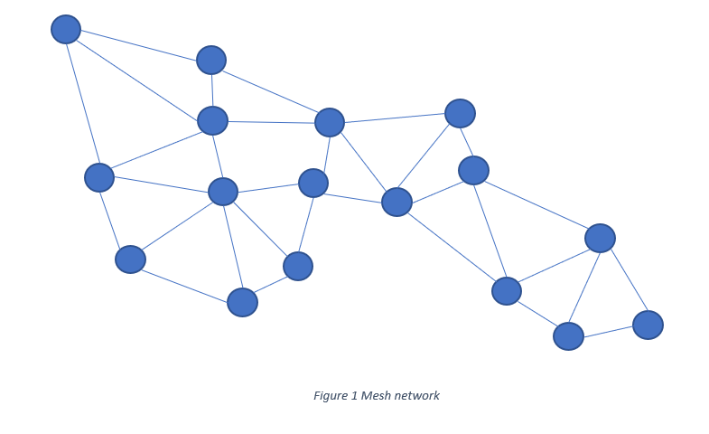
What we’re making
https://radiocrafts.com/why-is-multicasting-becoming-essential-for-mesh-networks/
Notes:
Daniel

Slide 12
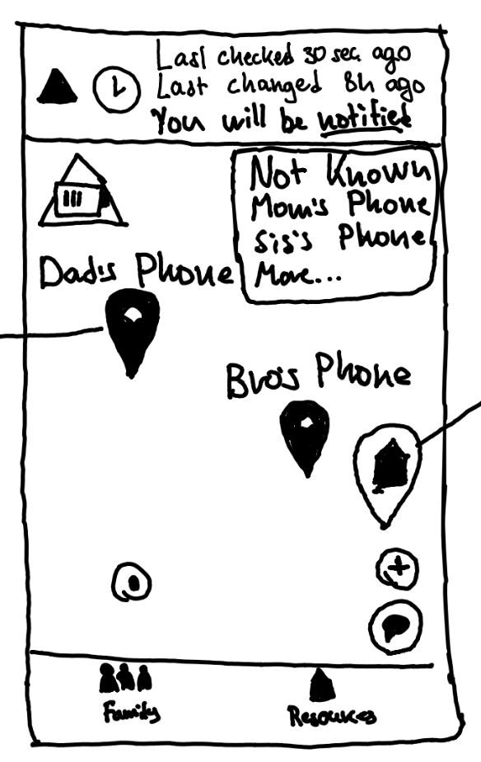
Main Screen
Use cases:
Mainstreamer: Locate family members and nearby shelters where to look for them.
Underserved: Keeping in contact with family members: checking where they are, setting a meeting point.
Notes:
Combined family and shelter view. (Dr. Burnett during work period)
“Last checked” and “last changed” banner: prevent repetitive checking. (Battery levels are critical, this is “intermittent reinforcement”) https://www.alleydog.com/glossary/definition.php?term=Intermittent+Reinforcement
“There is an increased likelihood the desired behavior will continue with intermittent reinforcement conditioning and the behavior lasts longer than continuous reinforcement.”
Chat button immediately accessible

Slide 13
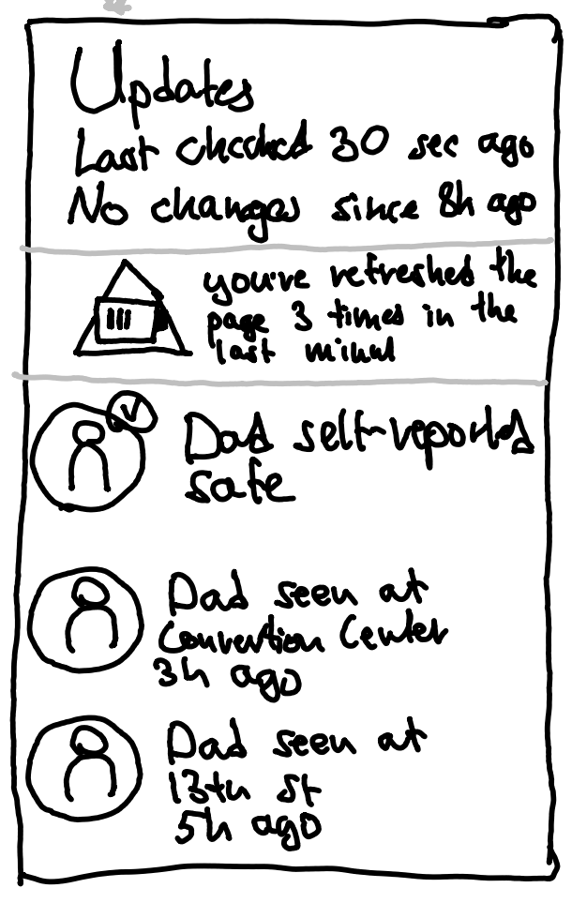
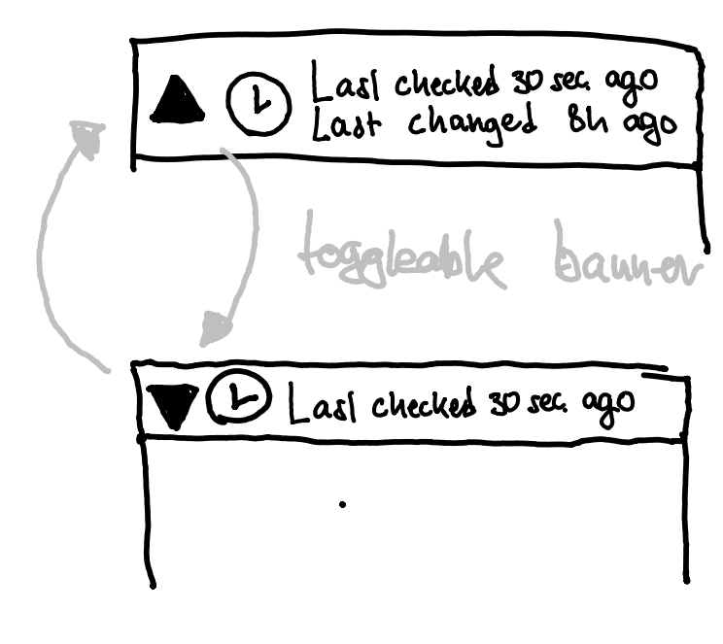
Toggleable Banners
Use cases:
Mainstreamer: see the last known location of a family member to ensure that they are safe.
Underserved: Keeping in contact with family members: checking where they are, setting a meeting point.

Slide 14
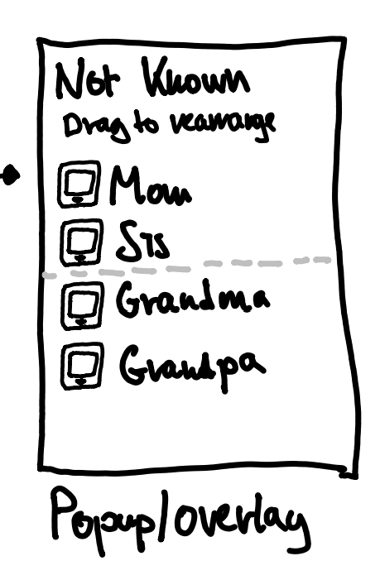
Unknown Family Members?
Use cases:
Mainstreamer: Locate family members and nearby shelters where to look for them.
Underserved: Keeping in contact with family members: checking where they are, setting a meeting point.
Notes:
Design decisions: limited processing capacity (stress, anxiety) => avoid cluttering screen => limit number of names in list
Users tend to feel a lack of control, and we don’t want to take away any more control: allow them to re-order the list themselves to see who’s on top.
To avoid giving false hope, ensure that locations are of phones, and not of people. We don’t want a stolen phone to show up as mom!

Slide 15
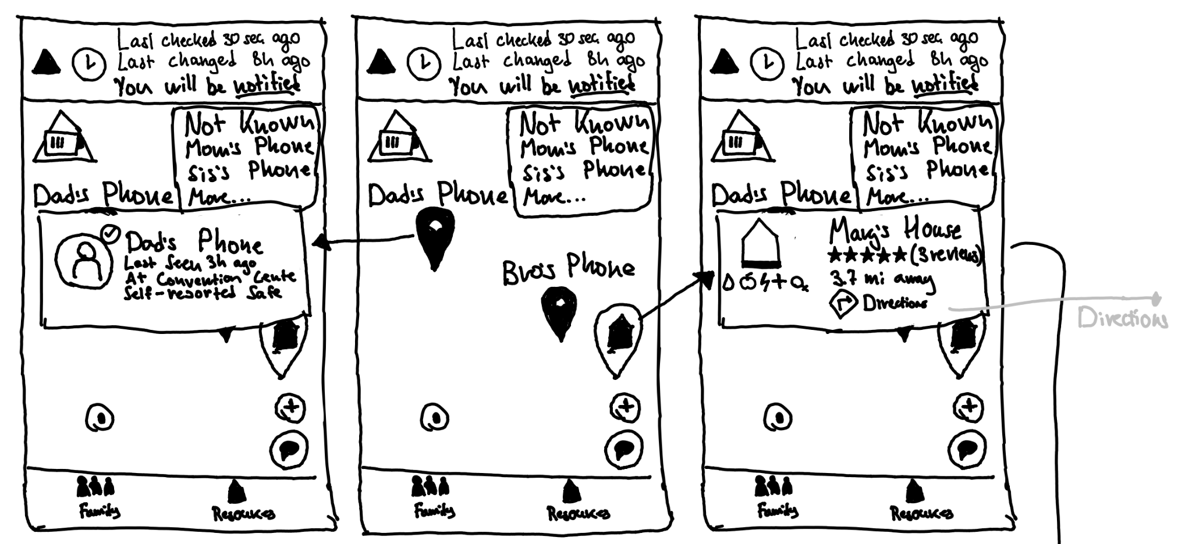
Checking on One Family Member
Use case:
Underserved: Keeping in contact with family members: checking where they are, setting a meeting point.
Notes:
r
Pop up

Slide 16
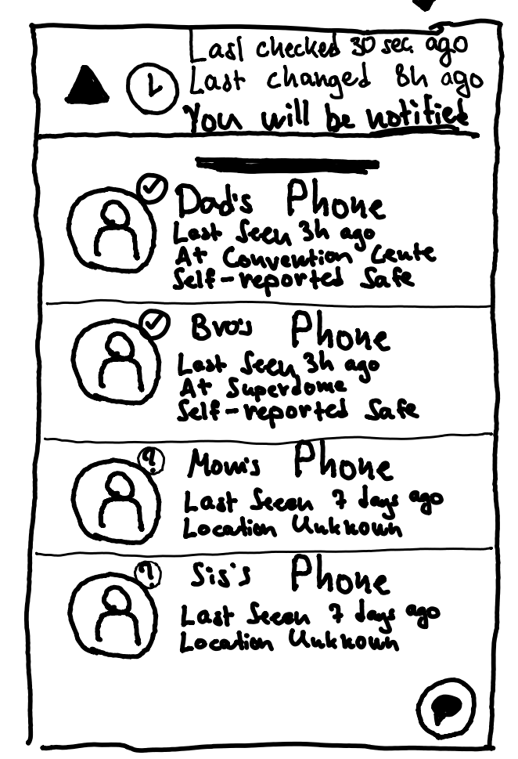
Checking on All Family Members
Use case:
Underserved: Keeping in contact with family members: checking where they are, setting a meeting point.
Notes:
r
Design considerations: design gallery 2 said there was too much text on the screen. We let users ask for more text instead of showing all the information at once.
Affordance with Google Maps

Slide 17
Same information, Different Format
Helps both
“depth first”
and
“breadth first” users equally
Notes:
r
Regardless of how people want to process information they can use either or and the information is there.
Many natural disasters are basically a random sample of people! They have tims and abbies
Tims/ Abbies have different information processing styles.
Depth-first
Breadth-first
We support both, and no one style gets more info than the other.
Consistency and standards are one of nielsen’ heuristics, o we make the list of people consistent with the information displayed on the map.

Slide 18
Looking into one Shelter
Use case:
Underserved: Locating temporary shelter, internet access, food.
Notes:
Since the main screen is a map that contains both family members and shelters. We chose the map because it provides more complete information to our users and lets them make decisions that are based both on their family members and on the nearby safe locations. In addition, not needing to switch screens helps reduce battery usage.

Slide 19
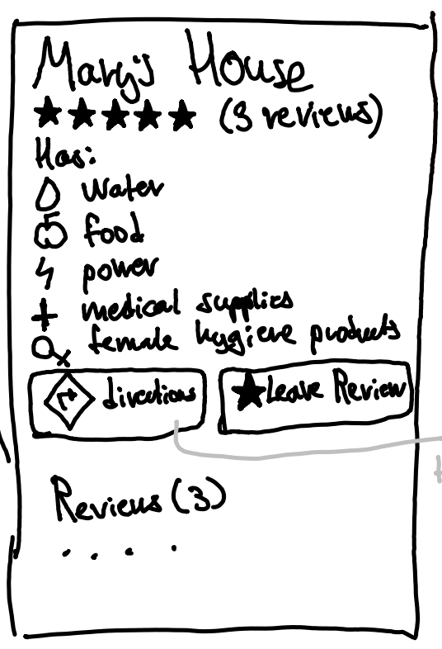
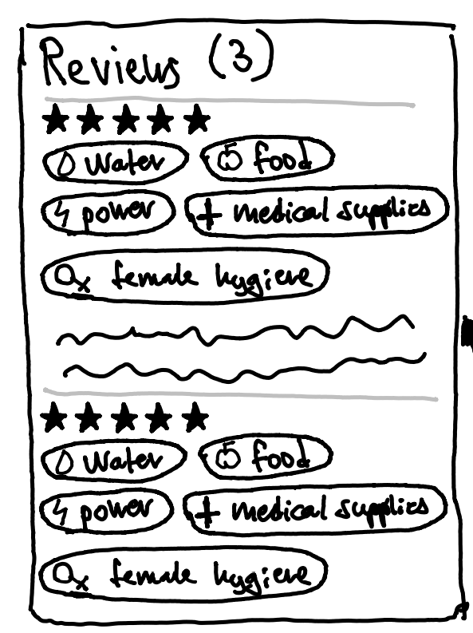
Even more Info on a Shelter
Notes:
Shelters are shown on the map along with family members. A user can then pan the map and look around to find a shelter that they like. Tapping the shelter marker on the map brings up a popup with the shelter’s name, rating. The rating is measured in stars because stars are a common system for reporting an abstract “quality” of something, and is found in widely used services like Google/Apple Maps and Yelp.

Slide 20
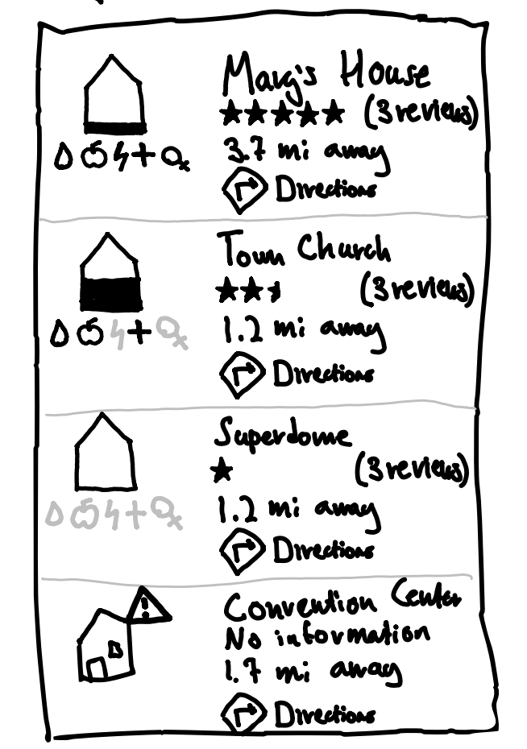
Looking into many Shelters
Use case:
Underserved: Locating temporary shelter, internet access, food.
Notes:
There will also be icons indicating what resources are available there (in the design, we have water, food, power, medical supplies, and hygiene products). RIght now we are aware that using the “gender” symbol might not be gender-inclusive. So even though the symbol is used in the design, we are on the lookout for something better.

Slide 22
What now?
Our user has located their family members
They surveyed the state of shelters in the surrounding area.
How to share locations with others?
How to get there?

Slide 23
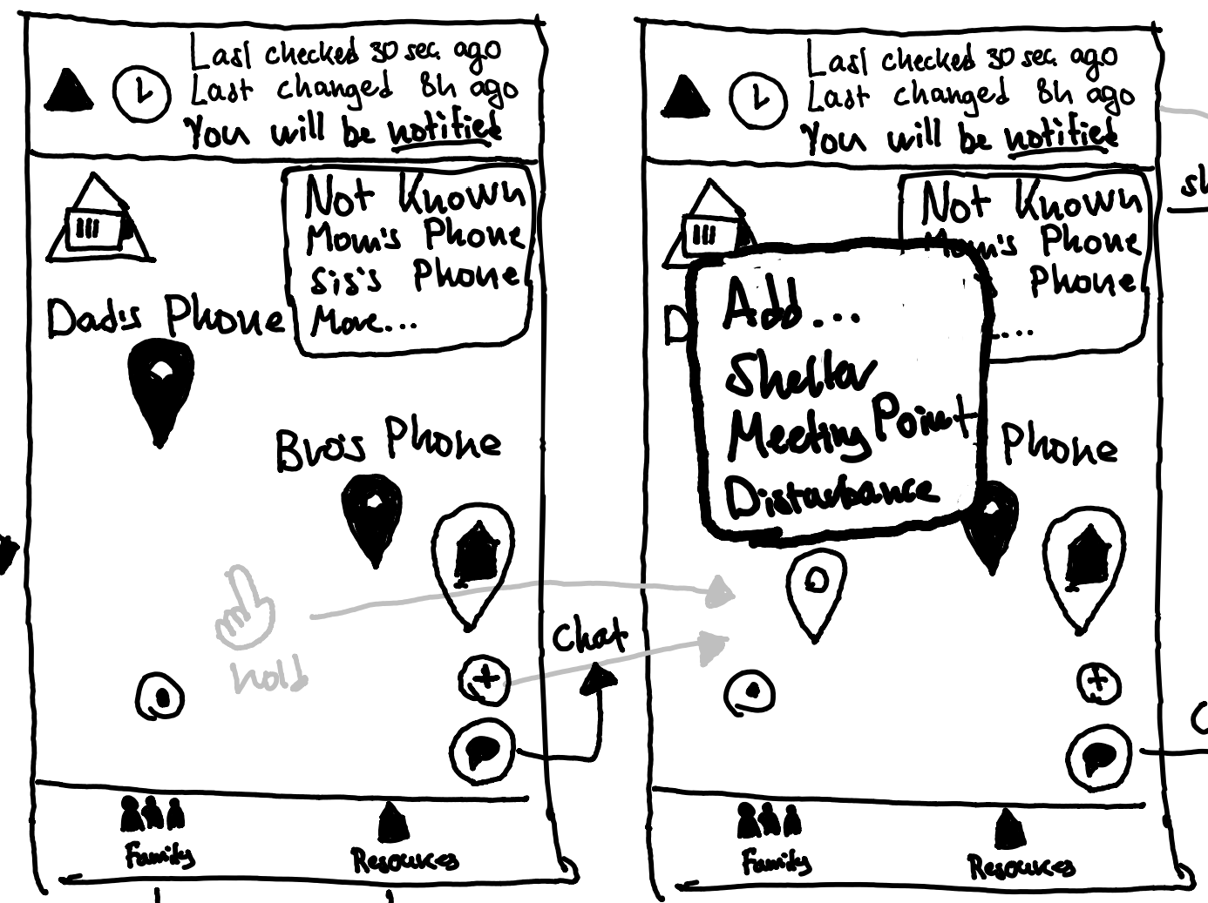
Adding a Meeting Point
Use cases:
Underserved: setting a meeting point.
Notes:
Hold a point on screen or plus button,
Users can add a shelter, set meeting point and report a danger area.

Slide 24
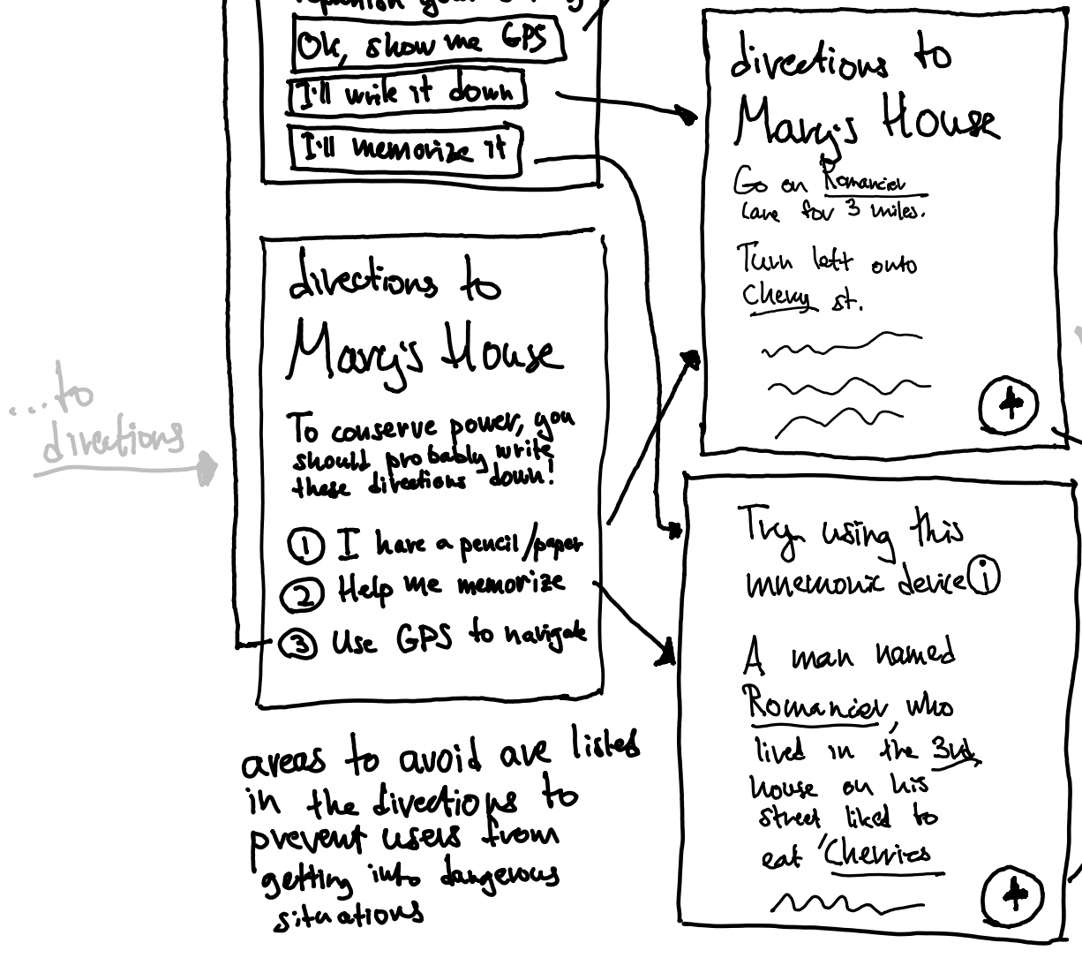
Navigation: Directions
Use cases:
Underserved: Generating directions, tutorials, other important information.
Notes:
Getting direction is also a important part of our app.
Since we still need to lower the power consumption, we give users 3 options to get directions.
First, we hope user can write directions on the paper so they don’t need to open the screen too frequently
Second, we gonna try to help users to memorize it, which we are still trying to find some efficient way to make it works.
Third, if users don’t care about battery, they can use GPS.

Slide 25
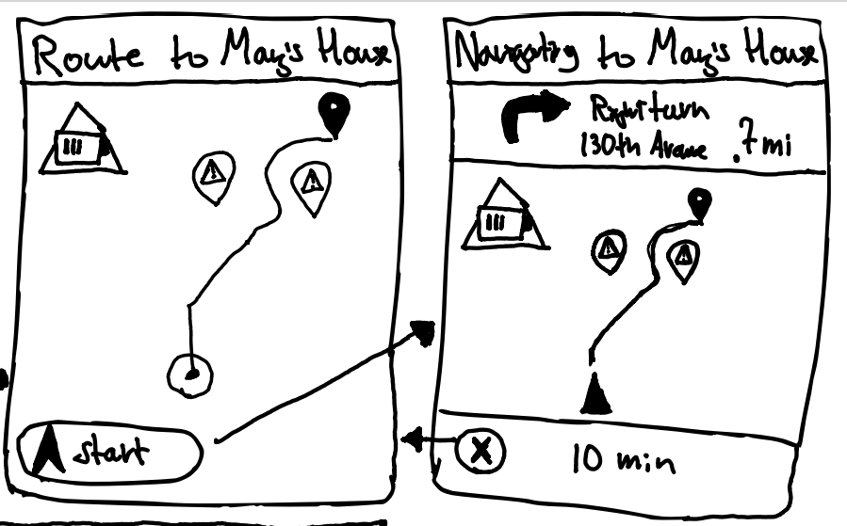
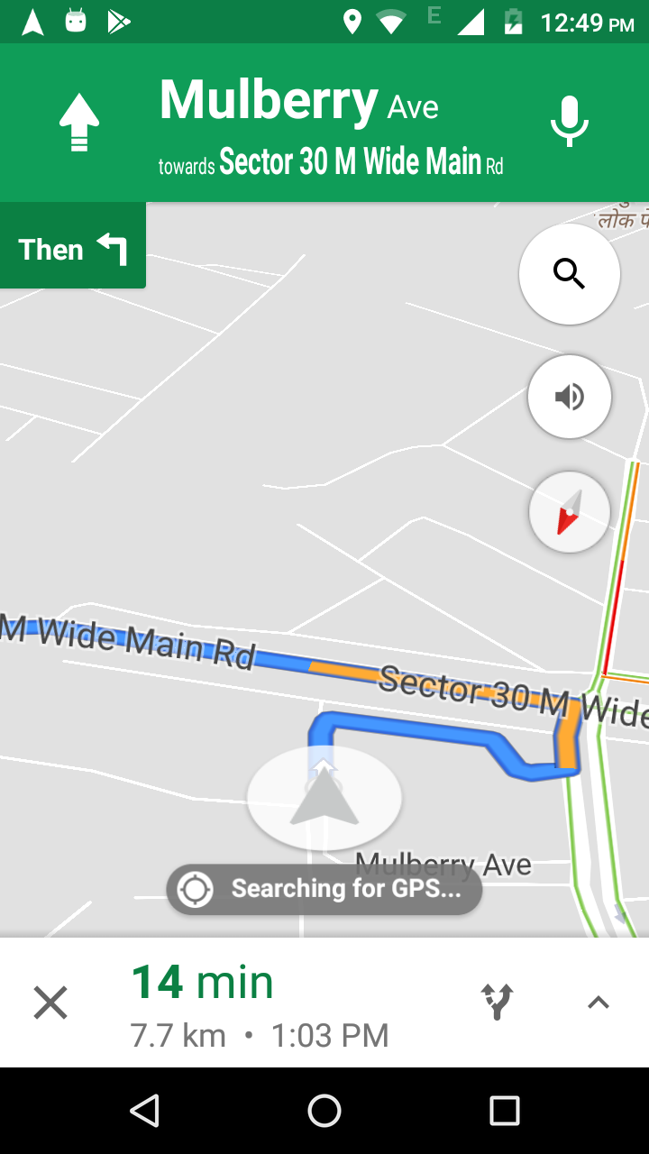
GPS Navigation
≈

Slide 26
Application Use Cases
Target Population
Mainstreamer
Finding and contacting people in the surrounding area even in the absence of cell signal.
Keeping in contact with family members: checking where they are, setting a meeting point.
Locating temporary shelter, internet access, food.
Generating directions, tutorials, other important information.
Locate family members and nearby shelters where to look for them.
See the status of a particular area or neighborhood.
See the last known location of a family member to ensure that they are safe.

Slide 27
Reference
20 Our Stories Beyond the Disaster
9 'Katrina brain': The invisible long-term toll of megastorms
26 Concussions: Alex's Story
29 Disaster and its impact on mental health: A narrative review
27 Reddit comment thread on concussions #1

